Slide 1
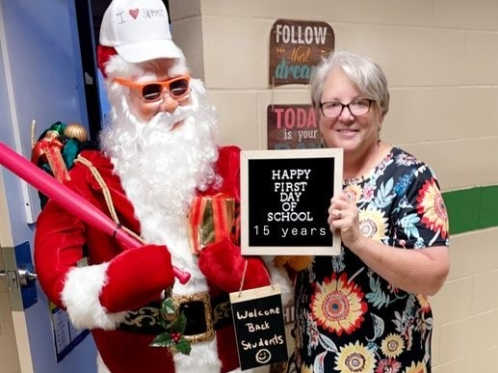
Virtual Parent Meeting with Mrs. Elliott
August 24
September 7
October 5
November 2
December 7
ZOOM Meeting at 5:30 pm
ID: 328 766 1773
Passcode: Summit

Slide 2
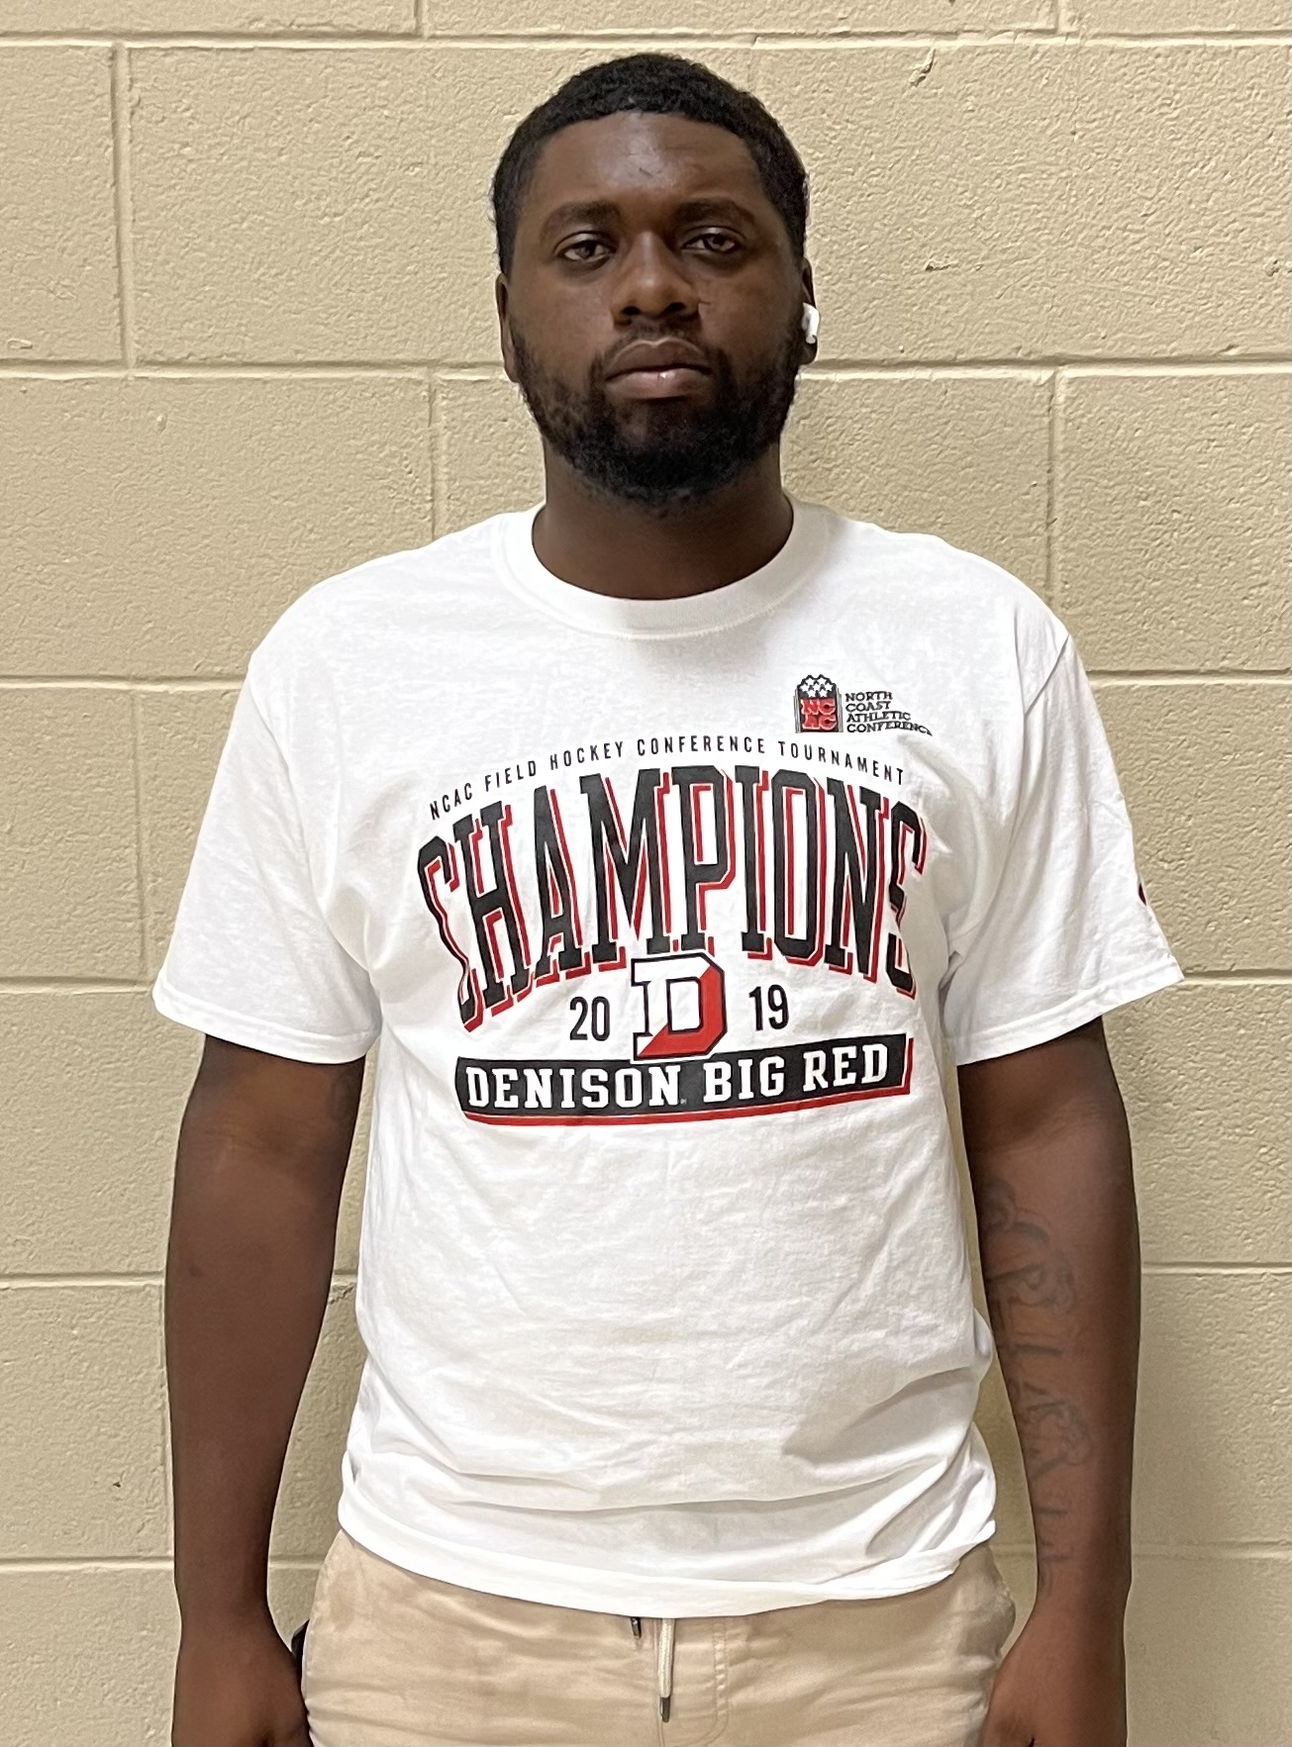
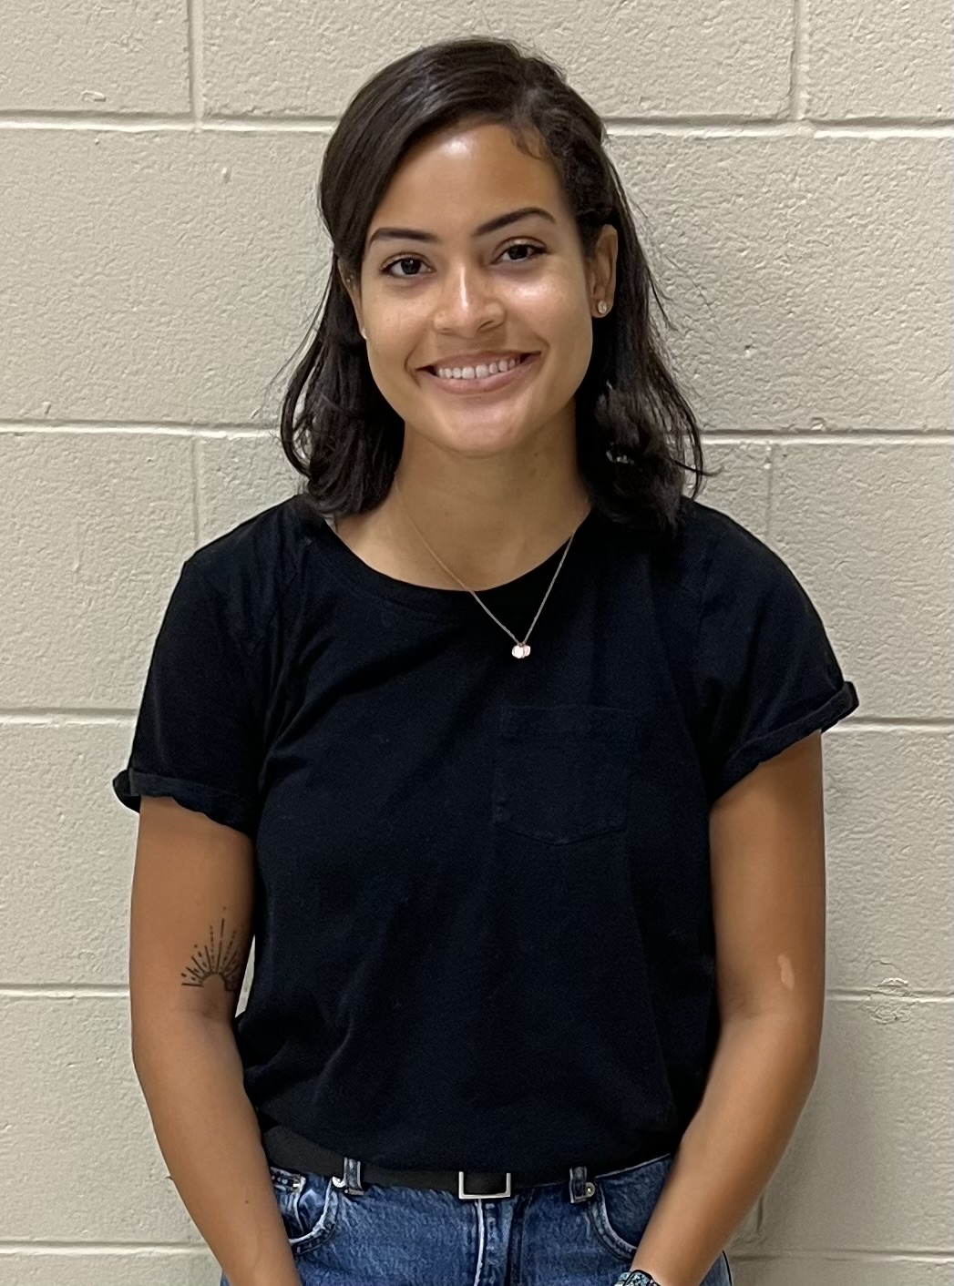
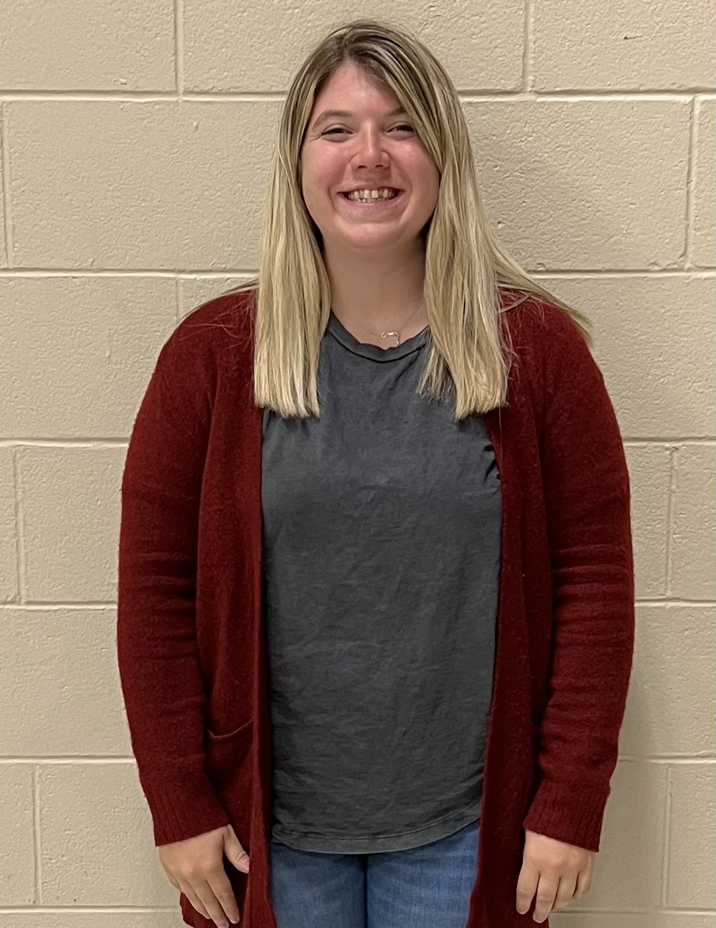
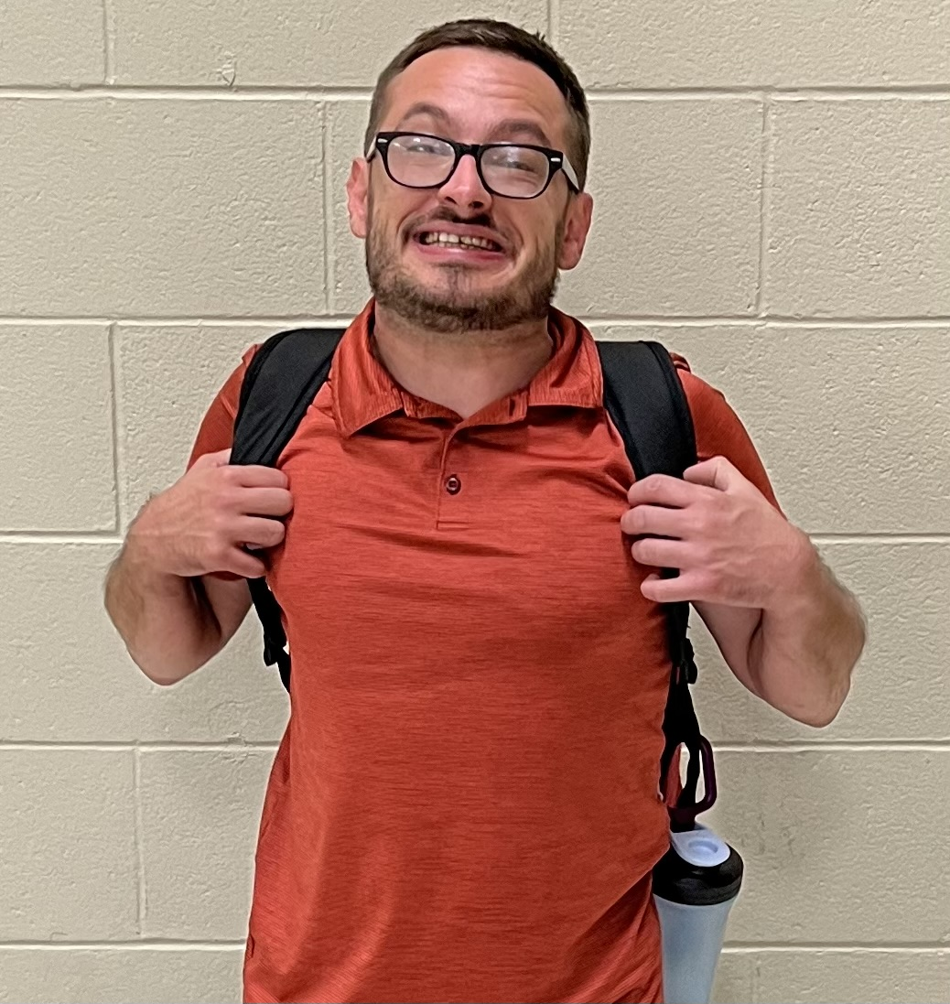
Returning Staff
Miss Carr coming soon!
Meet our new staff!

Slide 3
Bussing Issues
Please call 614-365-5074

Slide 4
Uniform Policy
Plain Color T-shirt
School appropriate pants

Slide 5
Cell Phones, Hoodies and Back Packs

Slide 6
Water Bottles
WATER ONLY

Slide 7
This is what we are going to do if we have to close due to staff being sick!
Packets

Slide 8
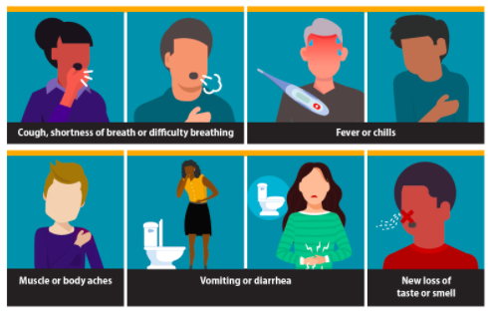
This plan is for staff illness ONLY! We will tell you when to do the packet!

Slide 9
Our Plan will be packets with optional technology components.
Your will be given 1 folder with work in it.
1 folder will be marked Day 1 and Day 3
The 2nd folder will be marked Day 2 and Day 4.
The folder was sent home on August 23, 2022
When we need to call off for staff illness you will be told which day to complete.
Work will be given in math, reading, writing, social studies and science.

Slide 10
Worksheet(s)
Each worksheet will include a QR Code.
The body of the page will be the work that needs to be completed.
Each page will also include an extension activity. These activities are optional and can be done to reinforce learning.

Slide 11
QR Codes
Video Directions
Instruction
Key points to remember
A Story
Example Problems

Slide 12
YouTube Videos
Website games
WebQuest
BrainPOP
Freckle
ABC Mouse
Prodigy
Vocabulary Games
Textbook Activities
Skill Practice Sites

Slide 13
How will attendance be taken?
Blended Learning
Packet Day ___1____
For attendance we are asking that you or your parent call (614) 237-5497 at the designated time to check in. Feel free to leave a message if there is no answer.
K-2- 8:30-9:00
3-5-9:00-9:30
6-8-9:30-10:00
Lastly, we will have a helpline if you are struggling with any of your work or would just like to check-in.
Call Line:___614-237-5497_________________________

Slide 14
No call during time slot = Absence
If you do not call, you will be marked absent.
A One Call will be sent at 11 am letting your parent know that you are being marked absent for the day.

Slide 15
Teacher Check-In Call
All students/parents will receive a call from a teacher before noon.
The check in call is to do the following:
-Check and make sure you’re OK.
-Ask if you have your packet and materials
-Help you set a goal to complete work
-Remind you to turn your packet in when you return
-Words of encouragement or positive remark
-Set up tutoring session if you need it

Slide 16
Helpline available 8:10 – 3:10 614-237-5497
Zoom Line:
Zoom.us
ID: 624-390-5349
PW: Help

Slide 17
Turn in Your Work!
You will get graded on your work!
You can always get help! Just call.
If you don’t understand your work, we will help you the next day in specials!
You MUST turn in the next day, or it doesn’t count!!!

Slide 18
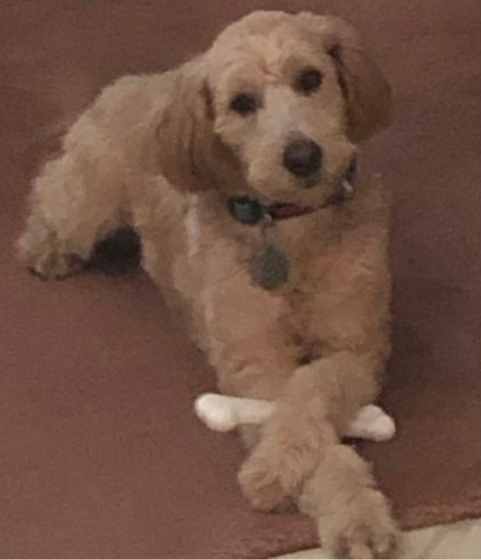
Thank you! Next Meeting: September 7th at 5:30 pm.

