Slide 1
Parent Meeting with Mrs. Elliott May 19, 2021

Slide 2
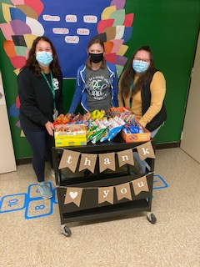
Teacher Appreciation Week

Slide 4
The Village Network is an experienced, multi-discipline behavioral health organization helping youth and families become resilient, healthy and have brighter futures.

Slide 10
Do you know anyone?
We have a few openings for next year!

